Slide 1
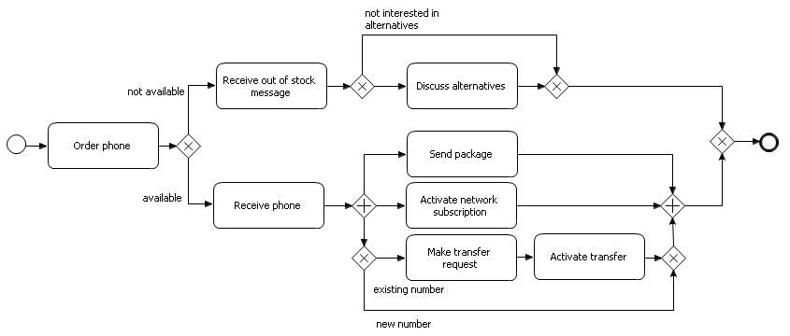
Structured Process Modeling
1. Model until path splits
2. Model first path until it splits again
3. Model first path of inner block
4. Model second path of inner block
5. Complete first path
12. Finish model
11. Complete second path
10. Complete inner block
6. Model second path until it splits again
7. Model paths of inner block
8. Model first path of inner inner block
9. Model second path of inner inner block

Slide 2
Happy Path First Modeling
6. Model the first exception
7. Again, model happy path first
8. Then, model the exception in this path as well
9. Finish with last exception
5. Complete happy path
1. Model until path splits
2. Model happy path first
3. Model paths of AND block
4. When path splits, model first happy flow

